Slide 1


Alpha Phi Omega
Chi Chapter at UCLA
Alpha Kappa / David A. Emery Term, Meeting 4
October 30, 2013
www.apo-x.org

Slide 2
Agenda
1. Officer Updates and Announcements
2. Chapter Business
a. Special Elections: Membership VPs
3. Last Announcements

Slide 3
President
Holly Fuong
president@apo-x.org
Executive Committee
excomm@apo-x.org

Slide 4

Leadership Workshops
Interested in hosting? Please come talk to me!

Slide 5
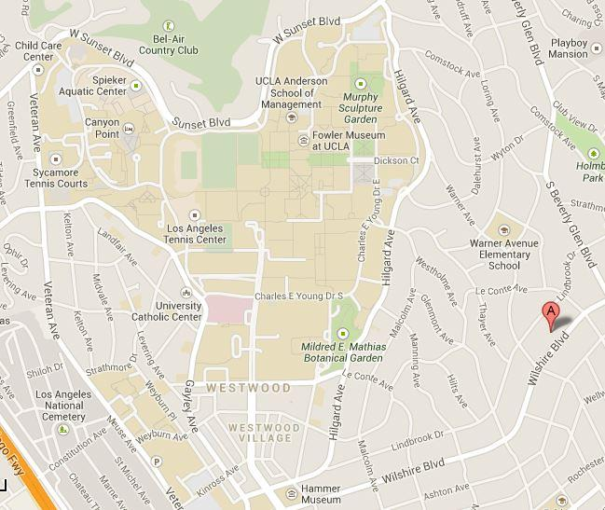
Philanthropy Updates
Tuesday 11/5
Wednesday 11/6
Friday 11/8
and more!!

Slide 6
Administrative VPs
Jacqueline Pan & Melanie Teepronpirut
admin@apo-x.org

Slide 7

Alumni Networking Night
November 7th, 7PM. Sign up on the calendar!!
Any specific careers y’all interested in? Tell us!
Alumni are taking time out of their busy lives and we should all go meet them! :)

Slide 8
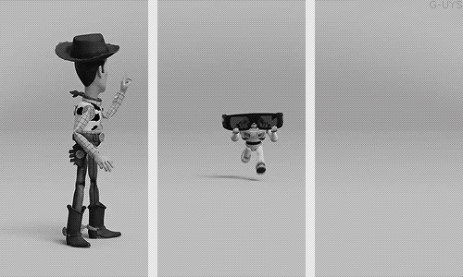
Newsletter #2
Look out for our next newsletter!

Slide 9
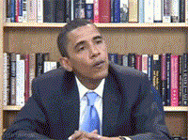
How to use the website
ASK AWAY & we are here to help. :)

Slide 10
Membership VPs
membership@apo-x.org

Slide 11
Business
Active Committees have been updated!
Please check the Alpha Kappa active tracker for your assigned committee.
Lots of fam events up on the calendar!
Sign up!

Slide 12
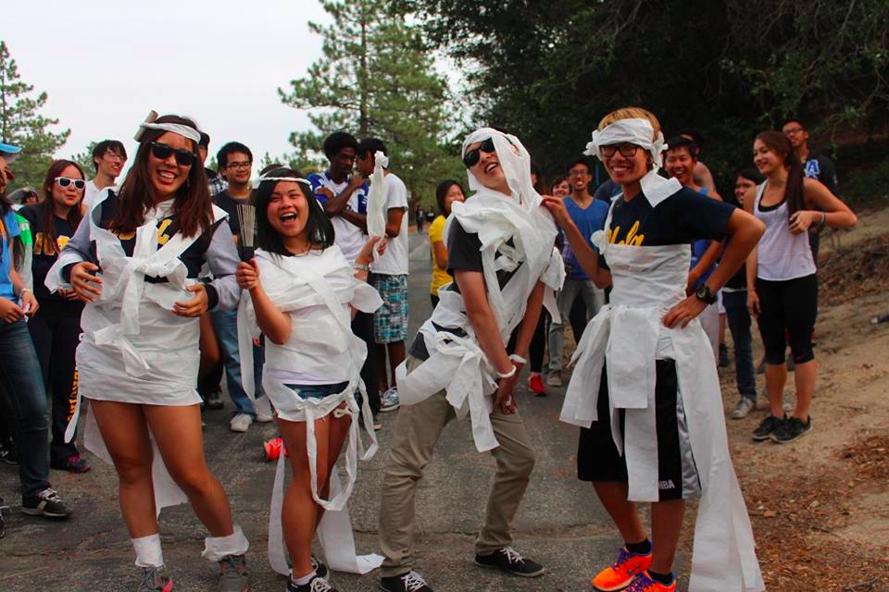
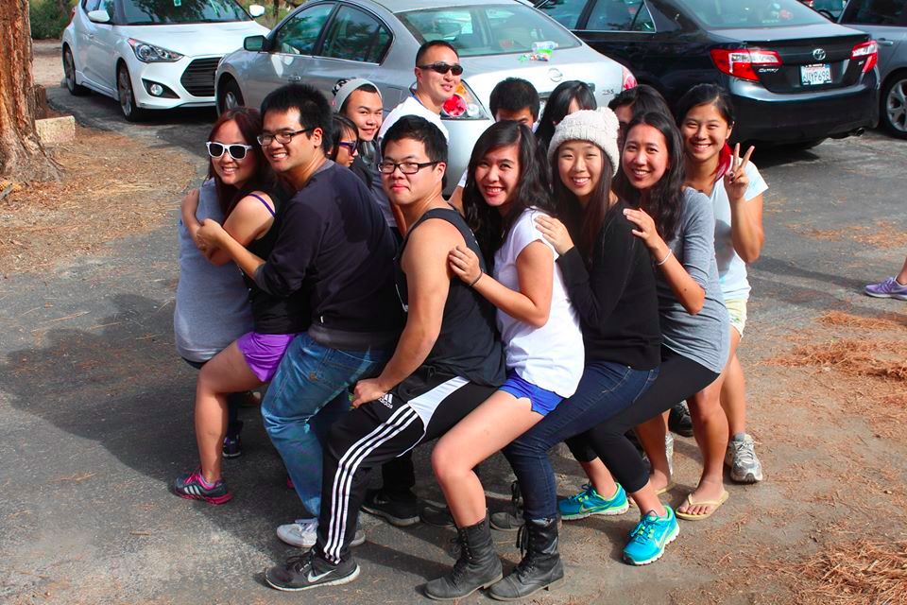
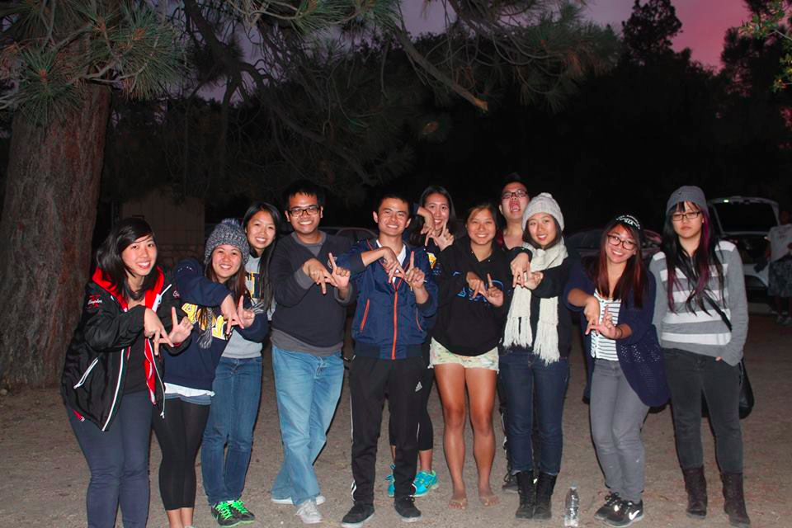
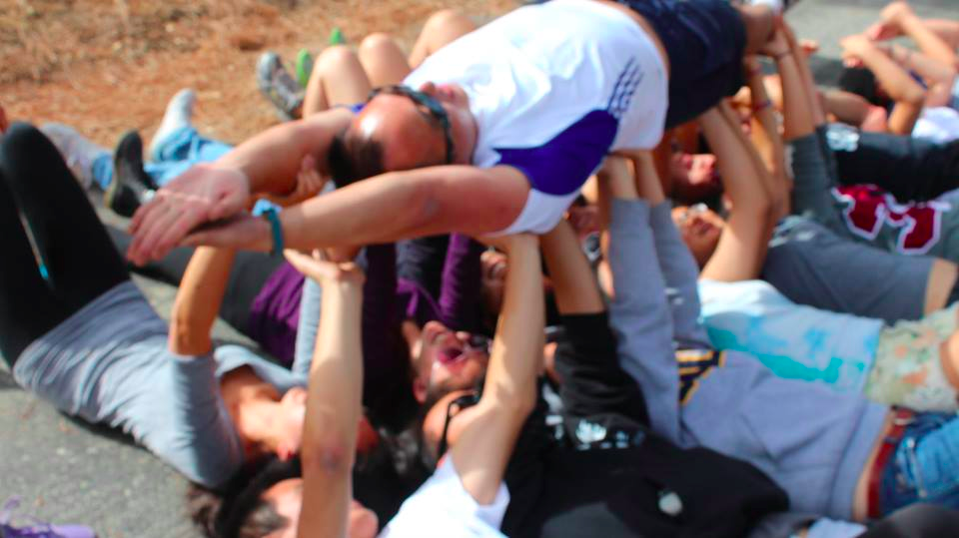
Campout
Thank you everyone for coming out! :D

Slide 13


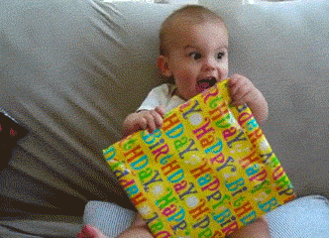
Revelations
THIS COMING SUNDAY. OH. MY. GAWD.

Slide 14

Spirit Committee
Where’s that family Spirit?!?!

Slide 15
Service VPs
Kevin Qiu & Gabrielle Taylor
service@apo-x.org

Slide 16
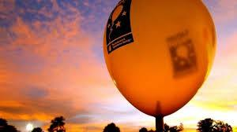
Saturday Service!
Light the Night Walk 11/2
Chair(s) needed for the morning shift,
Morning shift start time has been changed to 11 am - 3 pm
Chair needed for evening shift, 5:30 - 10:30
Drivers needed for all shifts!

Slide 17

Saturday Service!
EnrichLA Gardening 11/2
Event has been cancelled by the organization.
Sorry! But its not within our control.
Two hour event is up for
Friday, Nov. 8!

Slide 18
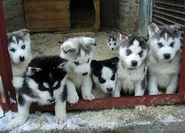
Puppy Up! Walk 11/3
Want to help further research and treatment for puppy cancer?
Puppy Up! Walk in Huntington, this Sunday!
7 am - 12 pm
We will be back in time for Revelations!

Slide 19
Don’t forget to sign up for:
DIVINE DESIGN: Choose your shifts and register ASAP
STONE CREEK W/ CIRCLE K: and help make Chi Chapter history!
Philanthropy Events at BELMONT VILLAGE: On Tuesdays, Wednesdays, & Fridays

Slide 20
Pledge Parents
Hamilton Luu & David Yuan
pledgeparents@apo-x.org

Slide 21
Events
Campout
Thanks for coming out!
Revelations
THIS SUNDAY
Even if you’re not picking up, come support your new line brothers!

Slide 22
Big/Lil Apps
List of Actives picking up will be sent tonight!
If, for whatever reason, you have not turned in your application, let us know so you can be included on the list!
HAVE AN OPEN MIND!

Slide 23
Requirements
Greek Alphabet
Name, uppercase, lowercase
10 Actives/10 Pledges
½ page
Music Video Mission

Slide 24
Finance VPs
Alejandra Chavez & Raymond Mai
finance@apo-x.org

Slide 25
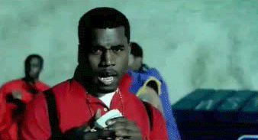
Financial Management
ALL of those on payment plans... next payment is next week, CM5
Excomm Expense Report will be sent out sometime by the end of this weekend
All outstanding reimbursements will be given to you by check next CM meeting. If you have a receipt, I can give you your check after meeting today
70+ actives paid dues... #SWAG.

Slide 26
FUNdraisers!
Restaurant
CPK (3) / Rubios(2)
In works with Chipotle, Veggie Grill, Five Guys, and BJs
Recycling
ink cartridges, bottles.

Slide 27

SLICK. HAVE A GREAT WEEK.

Slide 28
Fellowship VPs
Jessica Cui & Kevin Quizon
fellowship@apo-x.org

Slide 29
LGN MONEY IS DUE CM 6
PAY US $___$
$21 Subsidized
$25 Unsubsidized
And please sign up on the calendar!

Slide 30

WE GONNA NEED DRIVAHS
Please support the chapter by driving to LGN!
We will be having Driver Appreciation Raffle at LGN this term! :)
Yay Drivers!

Slide 31

Secret Brother Due Today!
Thank you all for participating! Hope you guys enjoyed it!
TASK DUE CM 6...
Write a card/letter on why you are thankful for this brother!
Get them something small that is thanksgiving related! :)

Slide 32
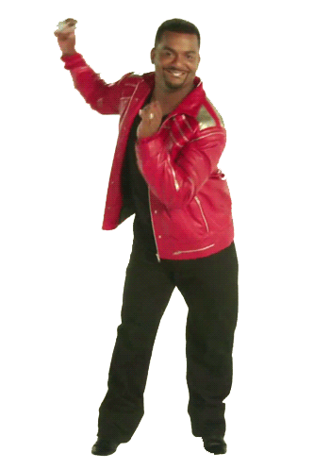
LGN TALENT SHOW
Let us know what you are going to perform by CM 5.
SHOW OFF YO CHI TALENT (:
MAKE IT APPROPRIATE LOL

Slide 33
Historian
Selena Saenz
historian@apo-x.org

Slide 34

Top Hit of the Week?

Slide 35
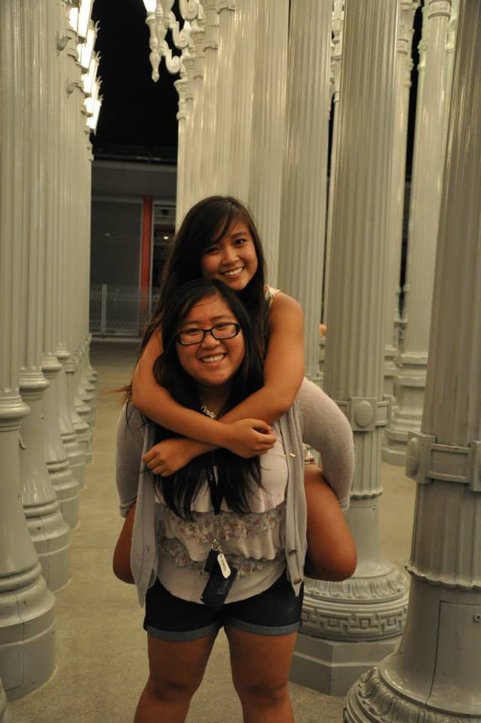
Top Hitz of the Week!

Slide 36
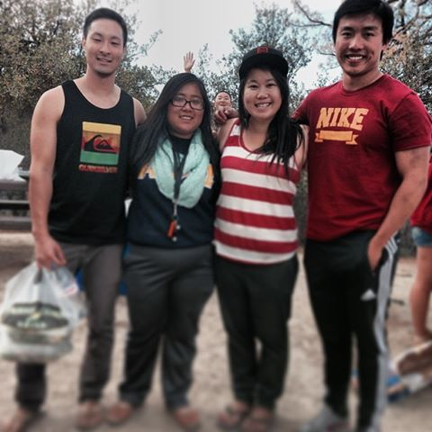
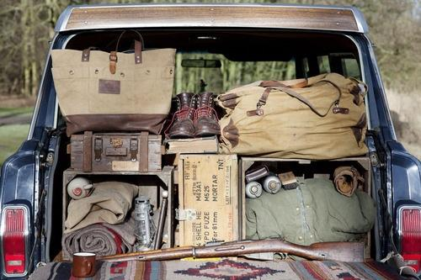
Honorable Mentions

Slide 37
CHI Trivia
Alpha Phi Omega known for helping people Chi fly higher than a g____ e____ Record pledge count cause we flyerin' Brothers are forever like a d______ Revelations coming up and you know we're stoked Big-little bonds stronger than a s___ o___ Boba runs hell yea we go a lot Always on your mind like a F___-__-___ 1976 female exclusion eradicated two years later, chi chapter got d________ 1997 was revolutionary chi chapter recharted on the first of _______

Slide 38
:D
Oh me oh my
My opinions don't lie
These people are so fly Their swag is sky high
Not even close to a tie The best family is ________
Credit to my lightbulbs …. Tin Vu and San Li!!

Slide 39
DO YOU KNOW WHAT TIME IT IS?

Slide 40
WEBISODE TIME!
Credit to Jessica Suhardjo!

Slide 41
Sergeant-at-Arms
Maria Valenzuela
saa@apo-x.org

Slide 42
Quorum?? What’s that?
A quorum is the minimum number of members of a deliberative assembly (a body that uses parliamentary procedure, such as a legislature) necessary to conduct the business of that group.

Slide 43
WE have PINS!!
Pledges:
If you received a paper pin with my signature please see me to get an actual pin replacement.
If you lost your pin and I gave you a paper signature, you owe me $5.00 - I know who you are!
Actives: I’ve always had pins so if you need one see me.

Slide 44

A.B.E.A
EMILY NEAI-PROEUNG
.Okay, so we all met up by the Bruin Store at 2pm because the designated meeting spot, ie. the Bruin Bear, was flooded with people trying to get their flu shot. We waited there for all of the attendees to come, minus Rui, Nicola and Diane since they were going to take his car there. The pledges got to mingle with each other and some actives during that time and Josh and I took the opportunity to get a flu shot while we waited. After that we walked to the bus stop and took the culver city bus to another bus stop in order to transfer. We finally got to Fox Studios but, alas, we went to the wrong location and had to get to the check in spot instead of the actual studio. We literally made everyone sprint to the check in location since we were cutting it close to time. We ended up in a shuttle terminal area and since we all looked tired and desperate, the staff helped us out and check us in for the tv taping. Everyone got a chance to cool down from their unexpected cardio workout for a while as we waiting for Rui, Nicola, and Diane. We eventually made it into the tv taping after they took our phones and electronics. Although we were all mostly separated from each other in seating, we all had a good time. The tv taping had an MC who tried to keep us entertained and lively by doing magic tricks, making jokes and putting on little mini challenges or shows. He was also just throwing mini twix, snicker, and three musketeer bars into the audience every now and then. In almost all the competitions the MC had, most of the pledges decided to participate in it. Sam broke out dancing with Jennifer and also sang a song from his country; they won themselves some candy. Judy won herself a homer simpson hat. Juana also went up to show off her tattoo; she also won candy. Channel participated in a magic trick and won a simpsons iphone case. Hoang and Brian were contestants in a blind dating game where they tried to sell themselves to the bachelorette. Hoang made the cutest impression of a fish trying to get food and Brian sang hte alphabet song, trying to woo the bachelorette. Sadly, none of them won her heart. Also, during a short intermission, they also provided us with mini water bottles and really large brownie squares to eat which was great because we were all starving at that point. The show itself was pretty funny, albeit pretty raunchy. Some of us even got to shake hand with some of the celebrities. After they finished shooting, we went to collect our phones and were off on our way back home. Overall, it was a good event, and aside from a few mishaps, the event went well. I would definitely recommend doing more tvtapings with Fox Studios.

Slide 45
Interchapter Chair
Olivia Pardo
interchapter@apo-x.org

Slide 46


YO YO… ICS IN THE HOUSE

Slide 47

“Let the Memories Begin!”
January 18th - 19th, 2014
University of California, Santa Cruz
Until 11/5: $60 without Banquet / $70 with Banquet
11/2-12/1: $70 without Banquet / $80 with Banquet
12/2-1/10: $80 without Banquet / $90 with Banquet
www.RegionalsX2014.squarespace.com
agn.apo.regionals@gmail.com

Slide 48
Chair of the
Advisory Committee
Tristan Darvin
cac@apo-x.org

Slide 49
CAC Office Hours
- Friday (11/01/13)
- 10:30AM to 12:30PM (or appointment)
- Somewhere in Westwood (Kerkchoff, possibly)
- Call/Text me: (760) 218-1479
- Email: apoxcac@gmail.com

Slide 50
Internship/Career
Due to being swamped this week...I’ll send you an email out this week! Sorry about that.

Slide 51
To: Alpha Kappa
If you have sent an email to me and have not yet received a response, then please just hold tight.
I do apologize for the delay. I am well aware of the emails you have sent me and I will get back to you as soon as possible.

Slide 52
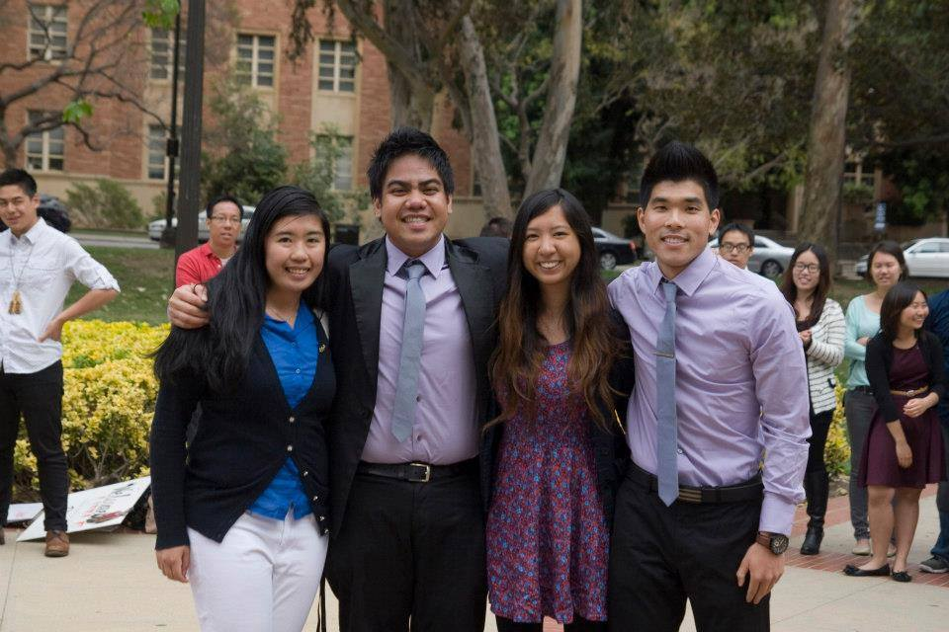
Words of Wisdom
“Short-term relationships stem from monetary and superficial value; while long-term relationships stem from effort from the heart and true acceptance”

Slide 53
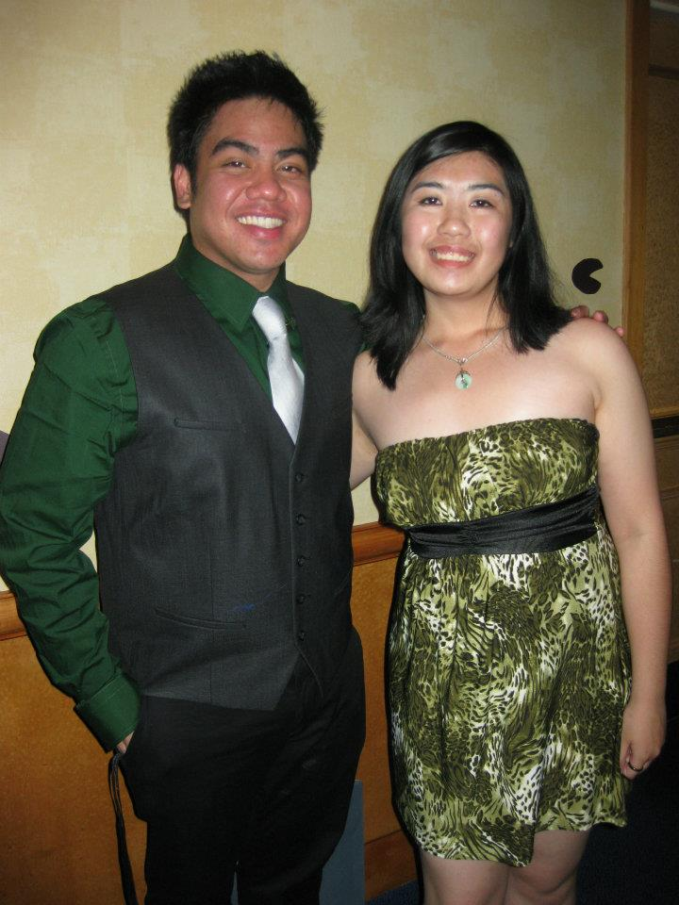
Thoughts on Big/Lil
“Open-minded”
Open-mindedness will lead to great things.

Slide 54
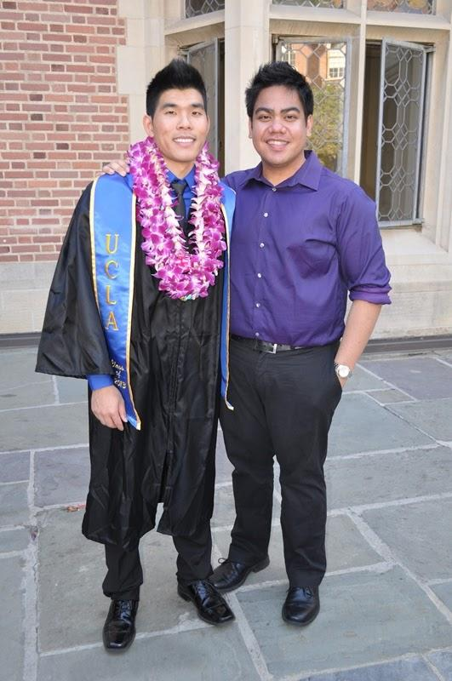
Thoughts on Big/Lil
“Meet Half-way”
Everybody has their differences, that’s why try to meet each other half-way!

Slide 55
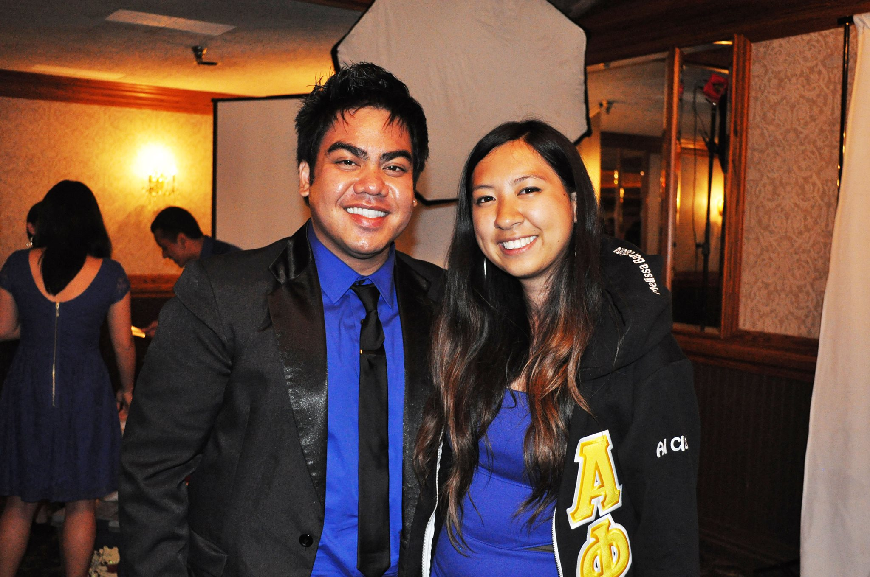
Thoughts on Big/Lil
“Be Considerate”
Everybody has feelings, don’t be so quick to judge just because they are older, not the same ethnicity, etc. You be suprised what may come your way.

Slide 56
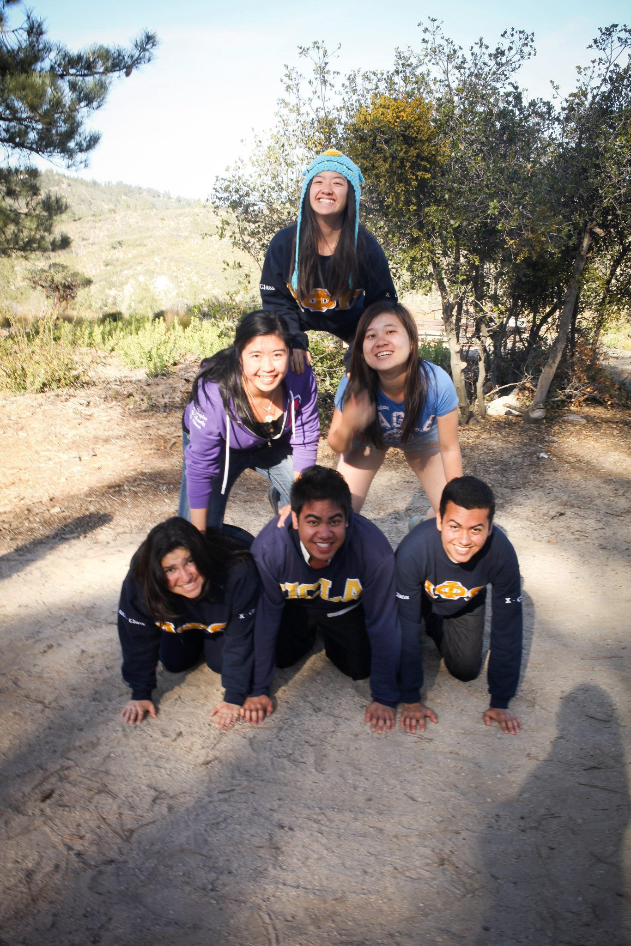
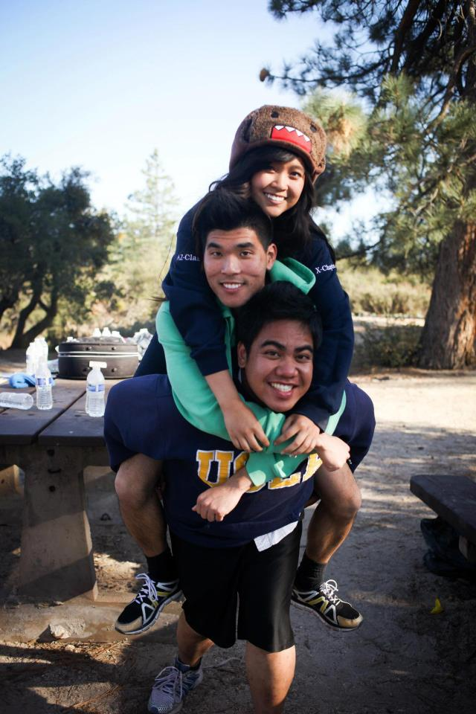
Spread the love!
Following these principles will help you find a true Big/Lil Relationship that you will be proud of and discover many great benefits as the years go by.

Slide 57
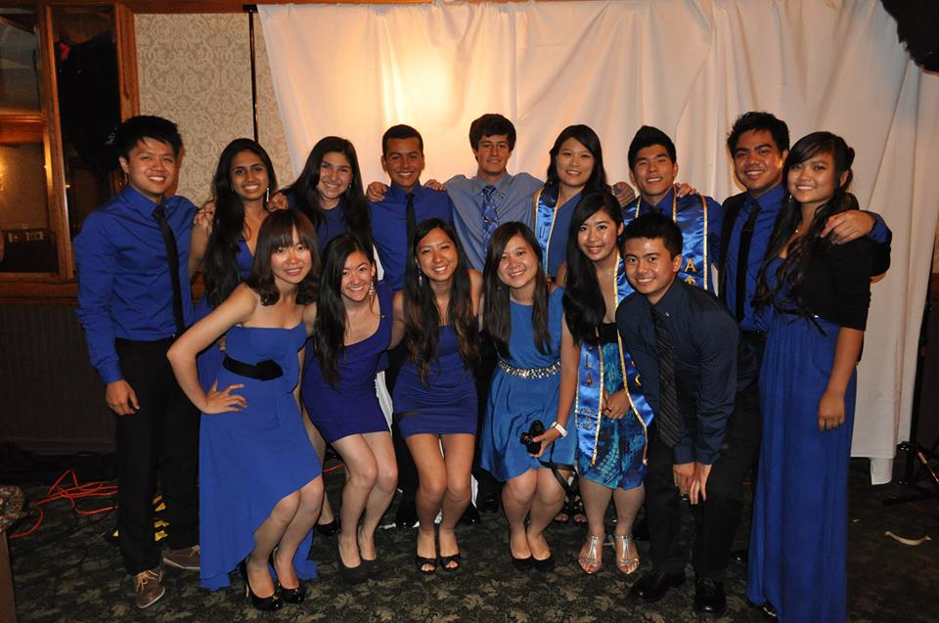
HAPPY REVELATIONS!

Slide 58
Chapter Business

Slide 59
Special Elections: Membership VP
Vivian Kwan
Jessica Suhardjo & Kristine Huynh

Slide 60
Last Announcements

